Slide 1
1. (20%) Determine whether the following statements are true or false.
（1）T
（2）F
（3）F
（4）T
（5）F
（6）T
（7）F
（8）F
（9）F
（10）F

Slide 2
（1）6
（2）22
（3）32
（4）20
（5）DEBFCA
（6）6
（7）216 5
（8）l,j,m

Slide 3
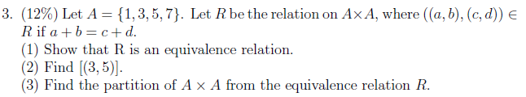
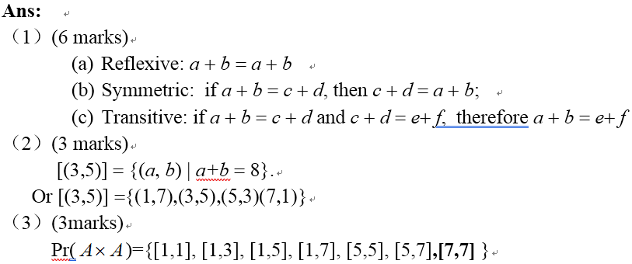

Slide 4

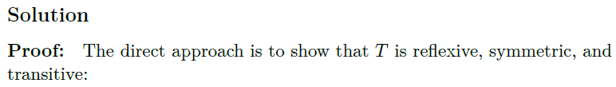
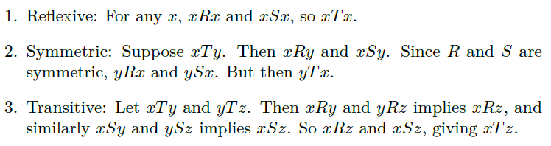

Slide 5
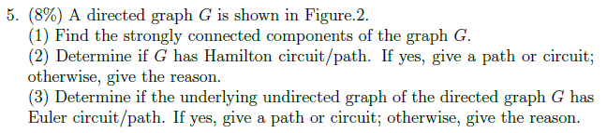
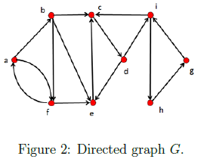
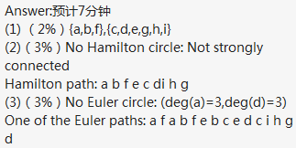

Slide 6
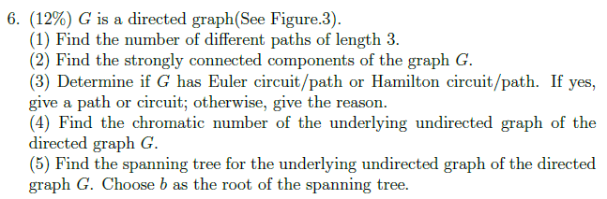
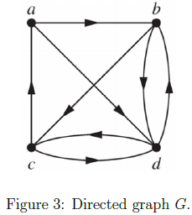
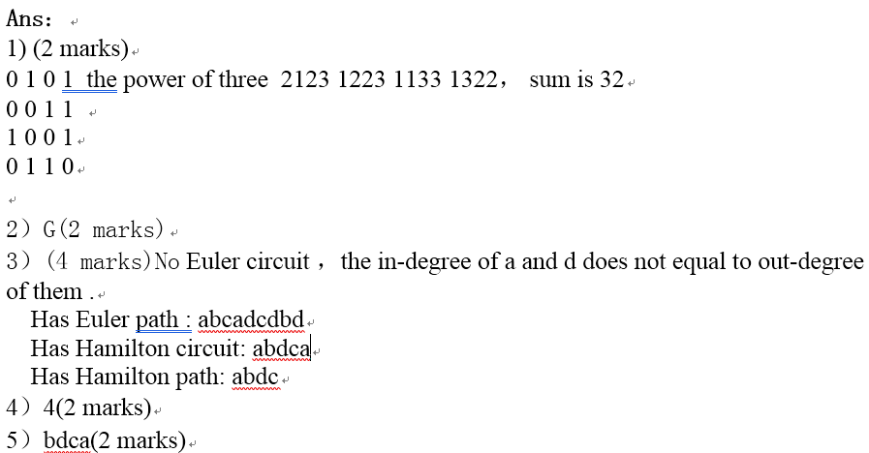

Slide 7

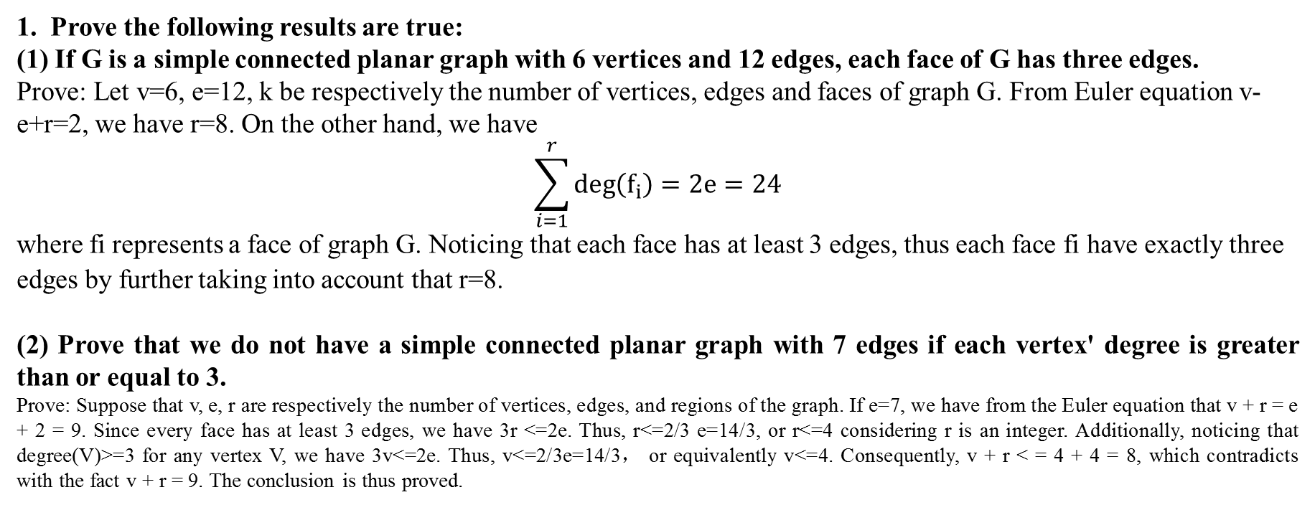
1. Prove the following results are true:
(1) If G is a simple connected planar graph with 6 vertices and 12 edges, each face of G has three edges.
Prove: Let v=6, e=12, k be respectively the number of vertices, edges and faces of graph G. From Euler equation v-e+r=2, we have r=8. On the other hand, we have
$$\sum_{i=1}^{r}{\deg\left(f_{i}\right)=2e=24}$$
where fi represents a face of graph G. Noticing that each face has at least 3 edges, thus each face fi have exactly three edges by further taking into account that r=8.
(2) Prove that we do not have a simple connected planar graph with 7 edges if each vertex' degree is greater than or equal to 3.
Prove: Suppose that v, e, r are respectively the number of vertices, edges, and regions of the graph. If e=7, we have from the Euler equation that v + r = e + 2 = 9. Since every face has at least 3 edges, we have 3r <=2e. Thus, r<=2/3 e=14/3, or r<=4 considering r is an integer. Additionally, noticing that degree(V)>=3 for any vertex V, we have 3v<=2e. Thus, v<=2/3e=14/3， or equivalently v<=4. Consequently, v + r < = 4 + 4 = 8, which contradicts with the fact v + r = 9. The conclusion is thus proved.

Slide 8


